Slide 1
Meeting 3
Will Yuhang Li

Slide 2
Outline
Fix the stimuli generation for the S/D task
Avoid generating the same word & pitch pair for different task at switched positions
Gorilla P/A & S/D experiment
Experiment flowchart
Stimuli distribution
Experiment result analysis (single subject)
P/A task
S/D task

Slide 3
Stimuli – Same/Different Task (Pitch)
Attend: Pitch
Same: -3 -1 3 0 same pitch
Beam Dual Gall Boon no same word at same loc
Boon Beam no repeating words
Dif: -3 3 -1 0 swapped pitch
Beam Dual Gall Deam no same word at same loc
Boon Beam Goose no repeating words
New: no same word pitch pair at switched position
Sequence of pitch(number) and word
-3 -1 3 0
Boon Goose Bean Balm
Notes:
Same pitch, the work

Slide 4
Stimuli – Same/Different Task (Word)
Attend: Word, randomized pitch
Same: -3 -2 no repeating pitch
-2 3 1 -1 no same pitch at same loc
Boon Goose Bean Balm same words
New: no same word-pitch pair at switched position
Dif: -3 -3 -2 no repeating pitch
-2 3 1 -1 no same pitch at same loc
Goose Boon Bean Balm swapped words
Sequence of pitch(number) and word
-3 -1 3 0
Boon Goose Bean Balm
Notes:
Same pitch, the wor

Slide 5
Stimuli – Present/Absent Task
Present Task & Attend: Pitch
3 (exist pitch)
Dual (nonexist word)
Present Task & Attend: Word
1 (nonexist pitch)
Bean (exist word)
Absent Task & Both Attend Conditions
1 (nonexist pitch)
Dual (nonexist word)
1st sequence of pitch(number) & word
-3 -1 3 0
Boon Goose Bean Balm
Notes:
Force to focus on pitch, word has no information; Reason not confuse people

Slide 6
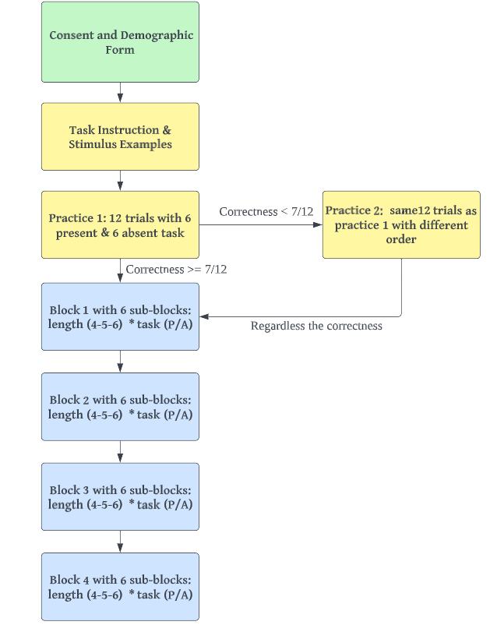
Design details - P/A task
4 blocks with 6 sub-blocks
6 sub-blocks: task-type(2) * length(3) = 6
Attend condition: pitch/word
Gender half male and half female & Randomly chosen
Total number of trails
60 trials/block * 4 block = 240 trials
Experiment time with rest: ~46 minutes

Slide 7
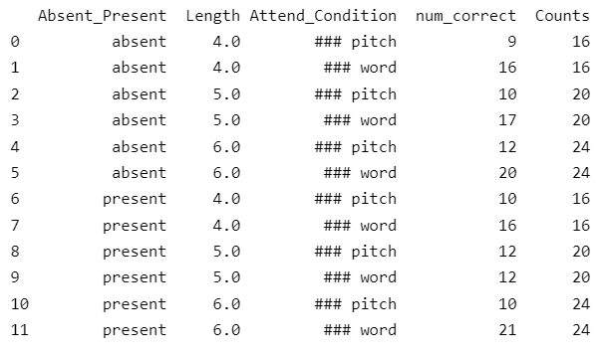
Stimuli details - P/A task
The stimuli distribution for 4 blocks, 240 trials
Notes:
*ignore the num_correct will discuss later

Slide 8
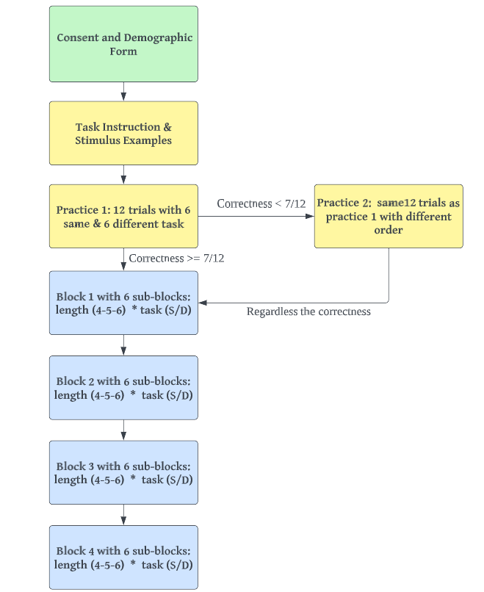
Design details - S/D task
4 blocks with 6 sub-blocks
6 sub-blocks: task-type(2) * length(3) = 6
Attend condition: pitch/word
Gender half male and half female & Randomly chosen
Total number of trails
48 trials/block * 4 block = 192 trials
Experiment time with rest: ~46 minutes

Slide 9
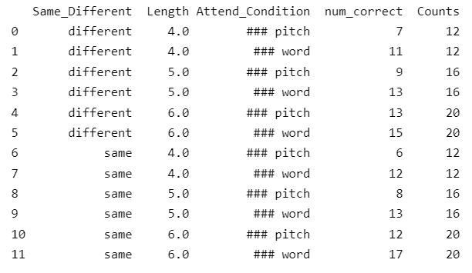
Stimuli details - S/D task
The stimuli distribution for 4 blocks, 192 trials

Slide 10
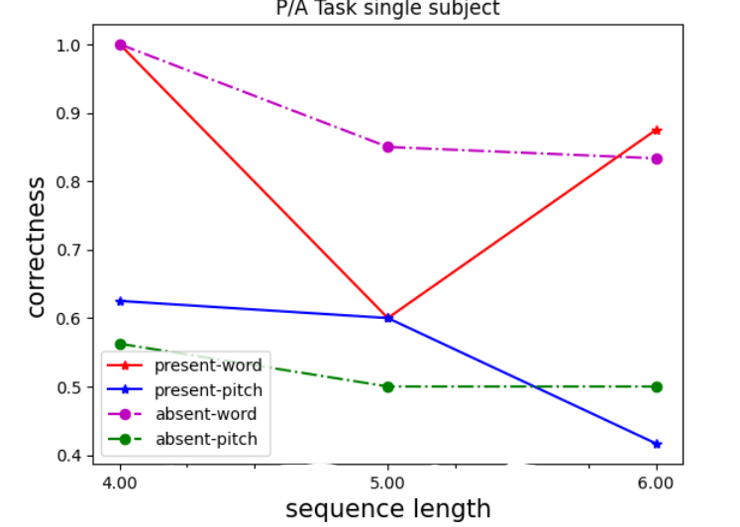
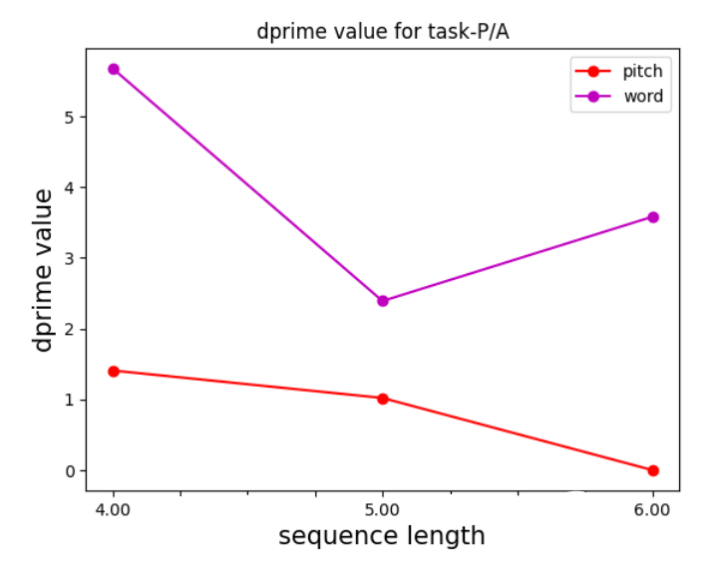
Result discuss for P/A Tasks - single subject

Slide 11
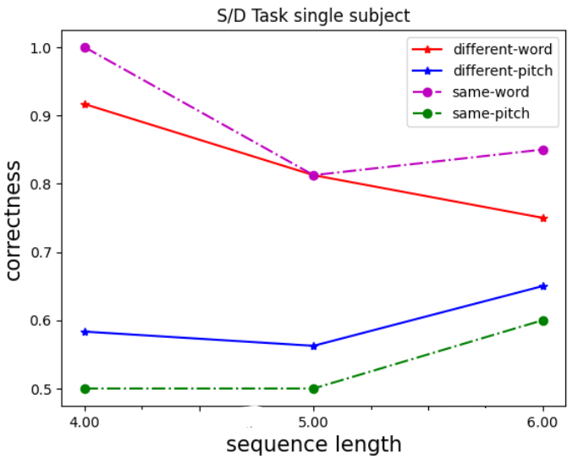
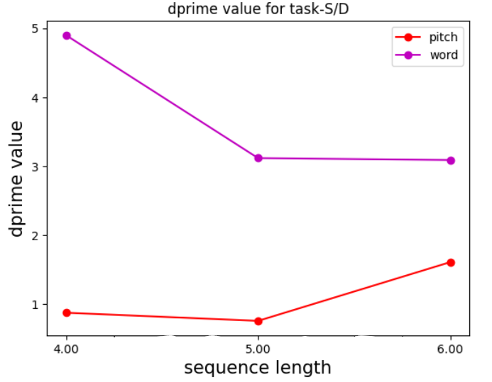
Result discuss for S/D Tasks - single subject
Notes:
Length 4 easy to remember the words compare the the pitch test with stimuli

Slide 12
Future
Plans
Increase the sequence length 4 - 6 - 8
finished for S/D task, didn’t pilot yet
Collect more data
Analysis data with other methods
Notes:
Think 6 7 8 but worry about too long

